Slide 1
SAP HANA on Azure

Slide 2
Abstract and learning objectives
Abstract
In this workshop, you will look at what is involved in deploying SAP HANA on Azure with the goals of designing for high availability, disaster recovery as well as supportability.
At the end of this workshop, you will be able to better design and deploy SAP HANA on Azure.
Learning objectives
Design high availability for SAP HANA workloads on Azure VMs
Design disaster recovery for SAP HANA workloads on Azure VMs

Slide 3
Step 1: Review the customer case study
Outcome
Analyze your customer needs.
Timeframe
15 minutes

Slide 4
Customer situation
Contoso Group
Contoso Group is a global pharmaceutical company with its headquarters based in Boston, US.
Contoso has been using SAP ERP and BW on HANA for its Finance/Logistics/Analytics systems on the HP-UX/Oracle platform.
Contoso Leadership and Planning Groups wants to drastically reduce server and storage hardware in their own datacenters to minimize IT related costs. Contoso has already a number of their non-SAP systems migrated to Azure. The leadership asked Contoso IT to look into the possibility of migrating its SAP HANA environment to cloud.
Contoso IT decided to leverage its knowledge of the Microsoft cloud platform and existing ExpressRoute connectivity and host its SAP landscape in Azure. The intention is to migrate the BW system first (go live in March CY18), and migrate ECC in Q4 of CY18. The multi-stage approach is supposed to minimize potential migration risks.
Considering that Contoso management team often uses BW to support their management decisions, the systems should be highly available and their performance must be predictable and consistent. In addition, the management team wants to leverage disaster recovery capabilities offered by Azure in order to ensure resiliency of the migrated environment in case the primary region hosting the new deployment becomes unavailable.
Before migrating the production environment, Contoso wants to test its new deployment approach by provisioning training, development, test, and UAT environments in Azure.

Slide 5
Customer situation
“Our operational dependencies on SAP applications force us to seek reasonably priced availability and disaster recovery capabilities for our production SAP HANA deployments.”
Andrew Cross, CIO, Contoso Group

Slide 6
Customer needs
Highly responsive systems with low network latency
In-memory database performance
High availability & disaster recovery
Enterprise data protection & security
Safe migration with downtime minimized
Access from HANA-based applications
Minimized cost

Slide 7
Customer needs (1/4)
Scope : SAP BW migration to HANA in Azure VMs
Go-live date : March 2018
Current BW (ABAP Unicode) on-premises with HP-UX/Oracle and application layer on Linux
ERP is kept on-premises (with HP-UX/Oracle) until December 2018
Data is transferred from ERP (on-premises) to BW (in Cloud) every hour
Customer requests flexible VM solution within Cloud to accommodate the BW workloads.
Use 1-year Reserved VM Instance option for Production VMs
(Option) Need to start to prepare for ERP migration to Cloud

Slide 8
Customer needs (2/4)
Sizing
Production (3-tier) with latest OS/DB fully certified and supported by SAP
HANA sizing memory requirement 1.2 TB, estimate 1.9 TB in 3 years
Throughput DB files at least 400MB/s [/hana/data]
Throughput DB Log files at least 250MB/s [/hana/log]
BW application servers: 15K SAPS
Certification is NOT required for non-Prod
QA (2-tier) HANA database server: 800 GB
Dev, Test (both 2-tier) HANA database server(s): 256 GB
Uptime – Prod: 24x7, 744 hrs/m, QA - 50 hrs/m, DEV/Test - 200 hrs/m

Slide 9
Customer needs (3/4)
Availability and Backup
Both HA and Non-HA options need to be proposed
With HA option, in case of server/storage issues, auto failover to complete within a few minutes, in case of a disaster recovery within 1 day
Long term backup – use reasonable backup storage in Cloud
Data loss not allowed
HANA DB log backup taken every 30 minutes
DB log backup to be kept for 1 day (DB restore to be fast)
HANA DB full backup every night
Daily HANA DB full backup to be retained for 1 month
Monthly HANA DB full backup for 1 year, annual for 3 years

Slide 10
Customer needs (4/4)
End user access
User locations – 300 from US, 50 LATAM, 50 Europe, 30 Asia - all intranet
Currently ExpressRoute is set up to Azure East US 2
User response time needs to be minimized

Slide 11
Customer questions and objections
ECC remains on-premises until Dec CY18 – how can we maintain integrations between ECC and BW?
How much does Azure cost? Give us a few options (e.g. HA and non-HA, DR and non-DR).
Do I have to pay for virtual machines when they are stopped?
Can I automate the shutdown of virtual machines at periodic times of day?

Slide 12
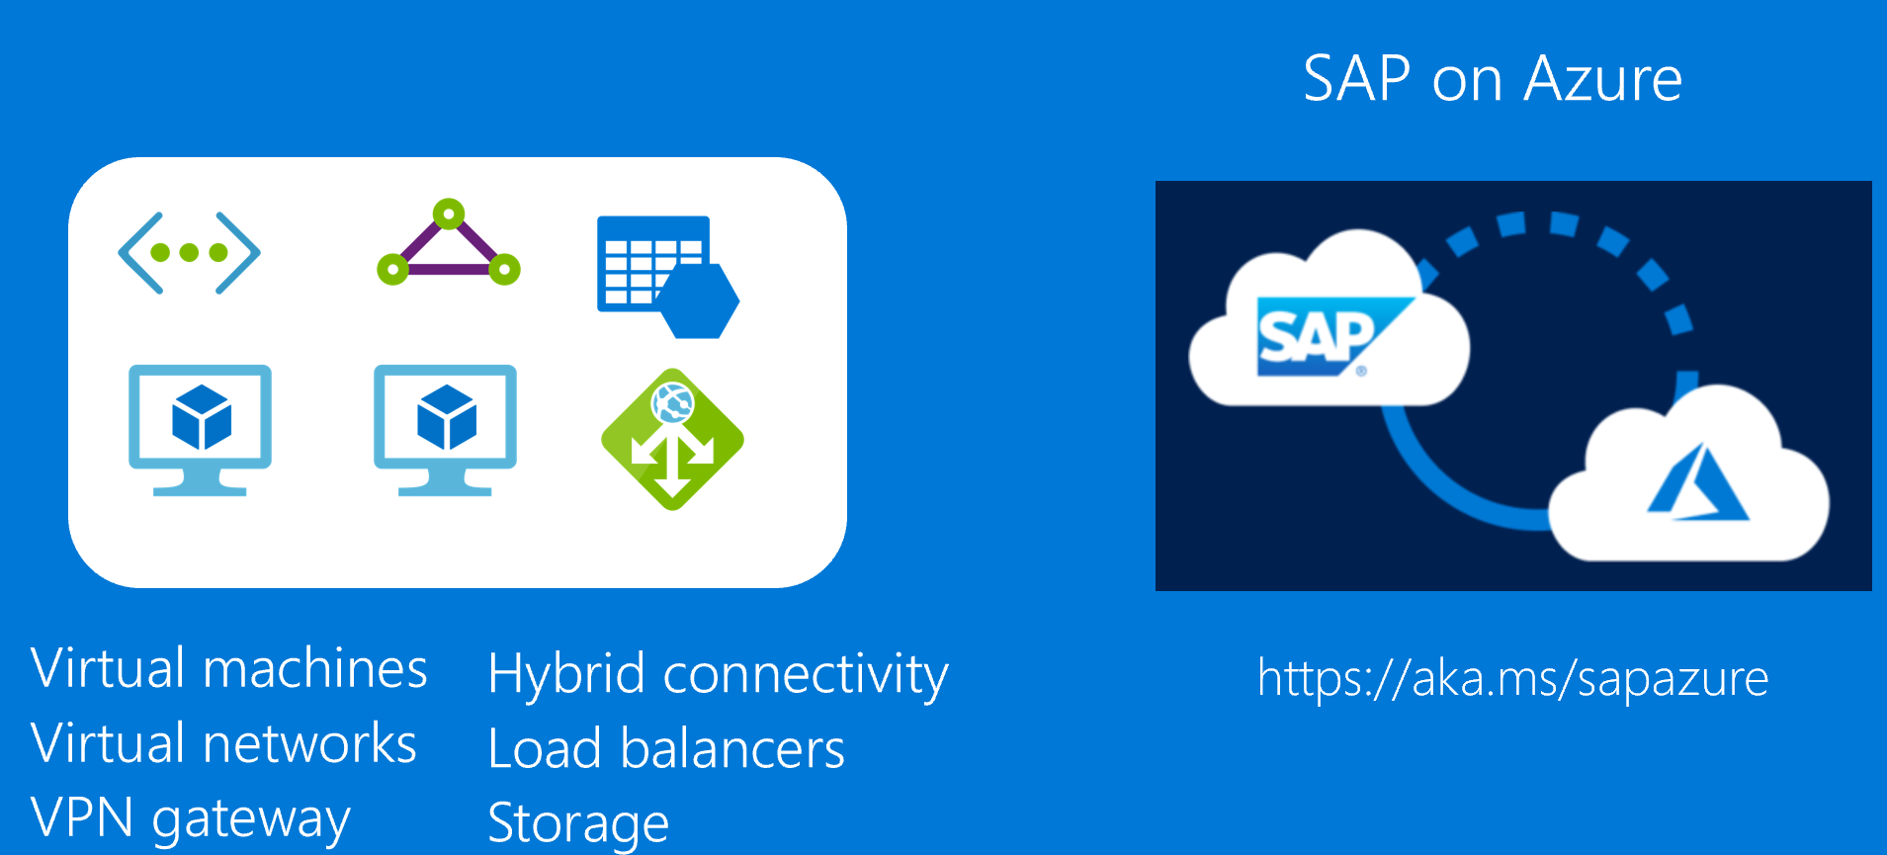
Common scenarios

Slide 13
Step 2: Design the solution
Outcome
Design a solution and prepare to present the solution to the target customer audience in a 15-minute chalk-talk format.
Timeframe
60 minutes
Business needs (10 minutes) | Respond to questions outlined in your guide and list the answers on a flipchart.
Design (35 minutes) | Design a solution for as many of the stated requirements as time allows. Show the solution on a flipchart.
Prepare (15 minutes) | Identify any customer needs that are not addressed with the proposed solution. Identify the benefits of your solution. Determine how you will respond to the customer’s objections. Prepare for a 15-minute presentation to the customer.

Slide 14
Step 3: Present the solution
Outcome
Present a solution to the target customer in a 15-minute chalk-talk format.
Timeframe
30 minutes (15 minutes for each team to present and receive feedback)
Directions
Pair with another table
One table is the Microsoft team and the other table is the customer
The Microsoft team presents their proposed solution to the customer
The customer asks one of the objections from the list of objections in the case study
The Microsoft team responds to the objection
The customer team gives feedback to the Microsoft team

Slide 15
Wrap-up
Outcome
Identify the preferred solution for the case study
Identify solutions designed by other teams
Timeframe
15 minutes

Slide 16
Preferred target audience
Business Development Manager (BDM) or Application Sponsor (CFO)
Funds projects & apps
Most interested in public cloud
Business Unit IT / Developers (Director of SAP Business Analysts, Director of SAP Operations)
Reports to BDM and is responsible for coding and testing apps
Big influencer of public cloud strategy
Central IT (VP of IT Operations)
Reports into CIO and responsible for operating datacenter
Concerned about shadow IT created issues: security/compliance, server sprawl, and lack of control

Slide 17
Preferred solution
Azure VMs - no HA
Azure VMs - HA with no DR
Azure VMs - HA and DR

Slide 18
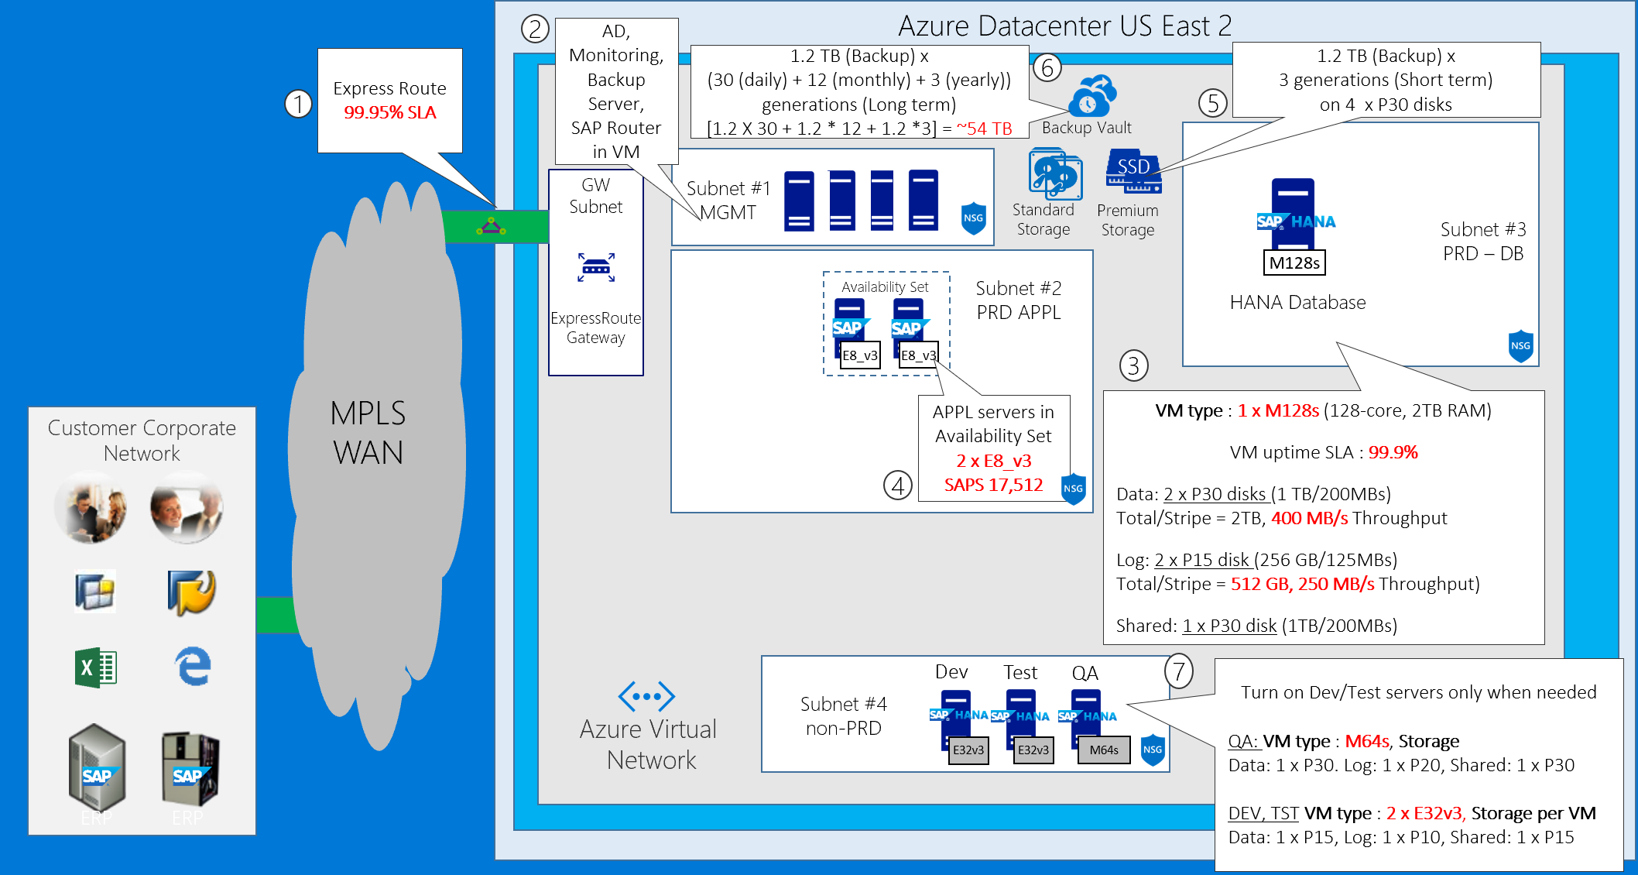
BW on HANA without HA
Notes:
Let us start with the Business Warehouse on HANA implemented by using Azure virtual machines without High Availability provisions
As you can see, we have a cross premises scenario, with the customer’s on-premises corporate network and an Azure datacenter in the East US region. The customer has already standard storage, which will allow us to also deploy the authentication, backup, and monitoring infrastructure.
For cross-premises connectivity, we leverage the MPLS-based ExpressRoute circuit that already exists between the customer’s network and a virtual network in the US East Azure region. This will allow us to extend our on-premises Active Directory by deploying Azure virtual machines and promoting them to become additional domain controllers in the existing on-premises domain.
We start by deploying a M128s size VM that will serve the role of the HANA DB production server and provision premium storage managed disks to contain the HANA data files, log files and shared (install) directory. We size storage according to our customer requirements and following TDI/storage best practice, with 2 x P30 disks for data files (Sizedata = 1 x RAM), each providing 1 TB of storage and 5,000 IOPS, striped yielding the a total of 2TB capacity, 400MB/s throughput and 10,000 IOPS. We also add four P10 disks, striped to facilitate 512 GB capacity, 400MB/s throughput and 2000 IOPS - sufficient to accommodate the HANA log files. Finally, we deploy 1 x P30 disk for the HANA shared/install directory. With the HANA DB virtual machine in place, we next provision a pair of virtual machines that will serve as the ASCS and the application server. According to customer requirements, the Business Warehouse application servers must be able to handle about 10,000 SAPS. Two D12v2s are rated at 6,680 each, giving us total of 13,360 SAPS. You might want to verify that these ratings yield the application severs operating at acceptable utilization levels, since some of the ratings represent SAPS at close to 100% server utilization. However, for the most part, this applies to scenarios that involve two tier architecture or the database tier in the three-tier architecture, which is not the case here.
We also use a M128s and a pair of E32v3s to build a two-tier QA, development and test environment. QA is a built as a database copy of PRD, therefore the following disks are attached, two P30s (data), four P10 (log) and one P30 shared(install). For DEV & TSTS - 2 P10s (data), 1 P10 (log), 2 P10 (shared)
Next, we implement a couple of Azure virtual machines to provide backup and monitoring functionality. The backup VM supports premium storage, which provides high performance and sufficient capacity with two P30 disks. For long term backups, we offload content of the local disks on the backup server to the Azure Backup vault.

Slide 19
Cost: BW on HANA without HA
Environment | Category | Service | Region | Quantity | Usage | Description | Cost | Rationale
Production | Compute | VM/M128s/Linux | US East 2 | 1 | RI/1yr | HANA PRD DB Server | $5584.5 | DB Size 1.2 TB - fits to 2TB M128s with head-room
Production | Storage | P30/1024 GB | US East 2 | 2 | - | HANA PRD DB Files | $245.76 | 2 TB capacity + 400 MB/s Throughput
Production | Storage | P15/256 GB | US East 2 | 2 | - | HANA PRD Log Files | $69.12 | 512 GB capacity + 250MB/s Throughput
Production | Storage | P30/1024 GB | US East 2 | 1 | - | HANA PRD Shared | $122.88 | 1 TB capacity
Production | Compute | VM/E8_v3/Linux | US East 2 | 2 | RI/1yr | SAP BW APPL Server | $548.00 | 17512 SAPS
QA | Compute | VM/M64s/Linux | US East 2 | 1 | 50 | HANA QA DB Server | $333.45 | DB Size 800 GB - fits to 1TB M64s with head-room
QA | Storage | P30/1024 GB | US East 2 | 1 | - | HANA QA DB Files | $122.88 | 1 TB capacity accomodates 800GB database
QA | Storage | P20/512 GB | US East 2 | 1 | - | HANA QA Log Files | $66.56 | 1/2 * RAM
QA | Storage | P30/1024 GB | US East 2 | 1 | - | HANA QA Shared | $122.88 | 1 * RAM
TEST | Compute | VM/E32_v3/Linux | US East 2 | 1 | 200 | HANA TEST DB Server | $468.20 | DB Size 256 GB - fits to E32_v3
TEST | Storage | P15/256 GB | US East 2 | 1 | - | HANA TEST DB Files | $34.56 | 1 * RAM
TEST | Storage | P10/128 GB | US East 2 | 1 | - | HANA TEST Log Files | $17.92 | 1/2 * RAM
TEST | Storage | P15/256 GB | US East 2 | 1 | - | HANA TEST Shared | $34.56 | 1 * RAM
DEV | Compute | VM/E32_v3/Linux | US East 2 | 1 | 200 | HANA TEST DB Server | $468.20 | DB Size 256 GB - fits to E32_v3
DEV | Storage | P15/256 GB | US East 2 | 1 | - | HANA TEST DB Files | $34.56 | 1 * RAM
DEV | Storage | P10/128 GB | US East 2 | 1 | - | HANA TEST Log Files | $17.92 | 1/2 * RAM
DEV | Storage | P15/256 GB | US East 2 | 1 | - | HANA TEST Shared | $34.56 | 1 * RAM
Backup | Storage | P30/1024 GB | US East 2 | 4 | - | Backup/Fast Short-Term | $491.52
Backup | Storage | Cold/BLOB | US East 2 | - | - | Backup/Long Term (52TB) | $840.00 | 1.2 X 30 + 1.2 * 12 + 1.2 *3 = ~54 TB
- | Network | Express Route | US East 2 | 1 |  | 500 Mbit | $290.00
- | Network | Express Route Data Plan | US East 2 | 1 |  | 5 TB Data-Plan | $128.00
- | Network | ER Gateway | US East 2 | 1 | 744 | ER GW High Performance | $364.56
 |  |  |  |  |  | Total | $13,183.08
NOT INCLUDED : AD, Backup, Monitoring Server, Database licenses, MPLS (telco), Microsoft Premier Support, Managed Services
Notes:
And here is detailed pricing information representing our first proposed solution. The bulk of charges is associated with the networking and compute components. More specifically, they include the cost of ExpressRoute unlimited data plan at 500 Mbps and the cost of the production HANA DB M128s virtual machine running on 24-7 basis.
The remaining costs include the compute components that constitute the SAP application tier and the infrastructure of our production environment, as well as compute components of the dev/test and QA environments. In addition, we need to account for the premium storage implemented across both the production and non-production virtual machines. Keep in mind that it is a monthly cost that does not depend on the usage patterns. We also have to take into account the cost of backup, which factors in the number of protected instances and the projected amount of occupied space.
Note that the current slide does not take into account licensing costs, ExpressRoute telco charges, pricing of the Microsoft Premier Support which is required when deploying SAP production solutions in Azure, and any managed services.

Slide 20
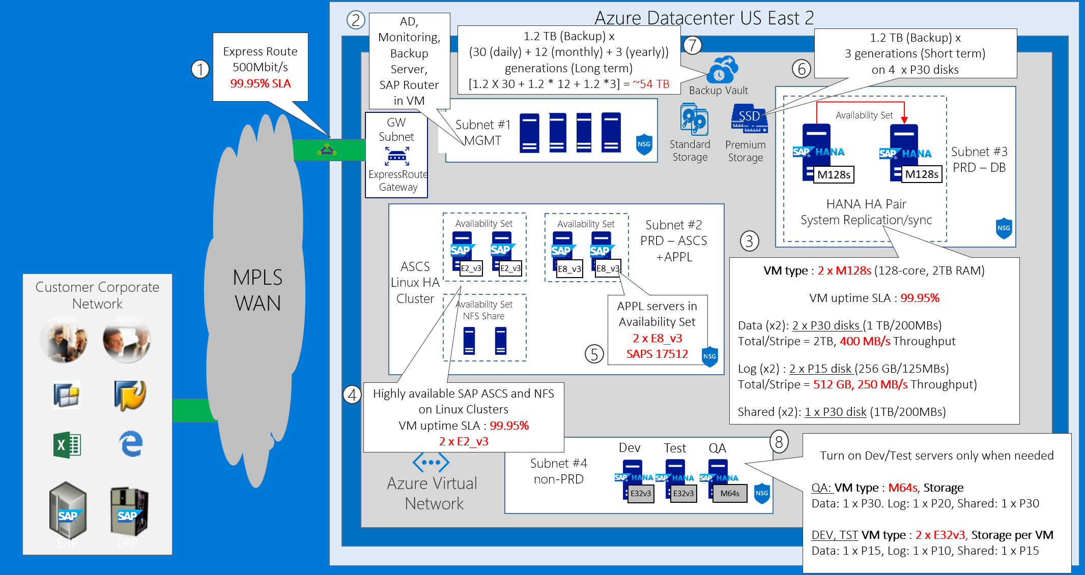
BW on HANA with HA
Notes:
Now let us extend our first solution by incorporating high availability provisions. To accomplish this, we deploy another M128s virtual machine in the same availability set as the first HANA DB virtual machine and set up HANA system replication between the two.
We also deploy a pair of virtual machines into the application tier and use Windows Failover clustering with shared storage emulated by SIOS Datakeeper to provide high-availability of the ASCS components. We also provide high availability by virtue of having two application servers in the same availability set.
To account for users that rely on SAP Fiori or PowerBI to interact with Business Warehouse on HANA and S/4 HANA we deploy a pair of virtual machines that host the relevant server side components, including Enterprise Portal and Power BI Enterprise Gateway.

Slide 21
Cost: BW on HANA with HA
Environment | Category | Service | Region | Quantity | Usage | Description | Cost | Rationale
Production | Compute | VM/M128s/Linux | US East 2 | 2 | RI/1yr | HANA PRD DB Server | $11169.00 | DB Size 1.2 TB - fits to 2TB M128s with head-room
Production | Storage | P30/1024 GB | US East 2 | 4 | - | HANA PRD DB Files | $491.52 | 2 TB capacity + 400 MB/s Throughput
Production | Storage | P15/256 GB | US East 2 | 4 | - | HANA PRD Log Files | $138.24 | 512 GB capacity + 250MB/s Throughput
Production | Storage | P30/1024 GB | US East 2 | 2 | - | HANA PRD Shared | $245.76 | 1 TB capacity
Production | Compute | VM/E8_v3/Linux | US East 2 | 2 | RI/1yr | SAP BW APPL Server | $548.00 | 17512 SAPS
Production | Compute | VM/E2_v3/Linux | US East 2 | 2 | RI/1yr | SAP BW ASCS/NFS | $137.00 | SAP ASCS/NFS Availability Set
Production | Compute | VM/E2_v3/Linux | US East 2 | 2 | RI/1yr | NFS Server | $137.00 | NFS Server Availability Set
QA | Compute | VM/M64s/Linux | US East 2 | 1 | 50 | HANA QA DB Server | $333.45 | DB Size 800 GB - fits to 1TB M64s with head-room
QA | Storage | P30/1024 GB | US East 2 | 1 | - | HANA QA DB Files | $122.88 | 1 TB capacity accomodates 800GB database
QA | Storage | P20/512 GB | US East 2 | 1 | - | HANA QA Log Files | $66.56 | 1/2 * RAM
QA | Storage | P30/1024 GB | US East 2 | 1 | - | HANA QA Shared | $122.88 | 1 * RAM
TEST | Compute | VM/E32_v3/Linux | US East 2 | 1 | 200 | HANA TEST DB Server | $468.20 | DB Size 256 GB - fits to E32_v3
TEST | Storage | P15/256 GB | US East 2 | 1 | - | HANA TEST DB Files | $34.56 | 1 * RAM
TEST | Storage | P10/128 GB | US East 2 | 1 | - | HANA TEST Log Files | $17.92 | 1/2 * RAM
TEST | Storage | P15/256 GB | US East 2 | 1 | - | HANA TEST Shared | $34.56 | 1 * RAM
DEV | Compute | VM/E32_v3/Linux | US East 2 | 1 | 200 | HANA TEST DB Server | $468.20 | DB Size 256 GB - fits to E32_v3
DEV | Storage | P15/256 GB | US East 2 | 1 | - | HANA TEST DB Files | $34.56 | 1 * RAM
DEV | Storage | P10/128 GB | US East 2 | 1 | - | HANA TEST Log Files | $17.92 | 1/2 * RAM
DEV | Storage | P15/256 GB | US East 2 | 1 | - | HANA TEST Shared | $34.56 | 1 * RAM
Backup | Storage | P30/1024 GB | US East 2 | 4 | - | Backup/Fast Short-Term | $491.52
Backup | Storage | Cold/BLOB | US East 2 | - | - | Backup/Long Term (52TB) | $840.00 | 1.2 X 30 + 1.2 * 12 + 1.2 *3 = ~54 TB
- | Network | Express Route | US East 2 | 1 |  | 500 Mbit | $290.00
- | Network | Express Route Data Plan | US East 2 | 1 |  | 5 TB Data-Plan | $128.00
- | Network | ER Gateway | US East 2 | 1 | 744 | ER GW High Performance | $364.56
 |  |  |  |  |  | Total | $19,479.34
NOT INCLUDED : AD, Backup, Monitoring Server, Database licenses, MPLS (telco), Microsoft Premier Support, Managed Services
Notes:
And here is detailed pricing information representing our first proposed solution. The bulk of charges is associated with the networking and compute components. More specifically, they include the cost of ExpressRoute unlimited data plan at 500 Mbps and the cost of the production HANA DB M128s virtual machine running on 24-7 basis.
The remaining costs include the compute components that constitute the SAP application tier and the infrastructure of our production environment, as well as compute components of the dev/test and QA environments. In addition, we need to account for the premium storage implemented across both the production and non-production virtual machines. Keep in mind that it is a monthly cost that does not depend on the usage patterns. We also have to take into account the cost of backup, which factors in the number of protected instances and the projected amount of occupied space.
Note that the current slide does not take into account licensing costs, ExpressRoute telco charges, pricing of the Microsoft Premier Support which is required when deploying SAP production solutions in Azure, and any managed services.

Slide 22
SAP HANA HA on Azure VMs Setup Sequence
Provision Azure infrastructure and two Azure Linux VMs (Azure)
Update Linux OS (Linux)
Install HA Extensions (Linux)
Set up disk layout (Linux)
Configure name resolution (Azure or Linux)
Install cluster (Linux)
Configure Corosync (Linux)
Install HANA HA packages (Linux)
Install SAP HANA (SAP)
Upgrade SAP Host Agent (SAP)
Configure HANA replication (SAP)
Configure Cluster Framework (Linux)
Create STONITH device (Azure and Linux)
Register SAP HANA resources (Linux)

Slide 23
SAP HANA HA on Azure VMs Setup Sequence – detailed
Provision Azure infrastructure and two Azure Linux VMs (SLES-for-SAP Applications 12 SP1) using the Azure Resource Manager model
Register SLES to ensure access to package repositories (BYOS only), add the public-cloud module, update OS (sudo zipper update)
Install HA Extensions (sudo zypper install sle-ha-release fence-agents)
Set up disk layout
Configure name resolution (DNS or /etc/hosts)
Notes:
Provision Azure infrastructure and two Azure Linux VMs (SLES-for-SAP Applications 12 SP1) using the Azure Resource Manager model
The same virtual network, subnet, and availability set, separate Premium Storage accounts
Attach Azure Premium storage disks to each VM
Create an internal load balancer
Back-end pool consisting of both Azure VMs, health probe set to TCP 62503, Load balancing rules: TCP 30315 and 30317, Direct Server Retu rn enabled for both
To automate, use the Github database template https://portal.azure.com/#create/Microsoft.Template/uri/https%3A%2F%2Fraw.githubusercontent.com%2FAzure%2Fazure-quickstart-templates%2Fmaster%2Fsap-3-tier-marketplace-image-multi-sid-db%2Fazuredeploy.json
Register SLES to ensure access to package repositories (BYOS only), add the public-cloud module, update OS (sudo zipper update)
Install HA Extensions (sudo zypper install sle-ha-release fence-agents)
4. Set up disk layout
Create physical volumes for all disks that you want to use
Create a volume group for the data files, the log files and the shared HANA directory
Create the logical volumes
Create the mount directories and copy the UUID of all logical volumes
Create fstab entries for the three logical volumes
Mount the new volumes

Slide 24
SAP HANA HA on Azure VMs Setup Sequence – (continued)
Install cluster on the first node (sudo ha-cluster-init) and join the second node to the cluster (sudo ha-cluster-join)
Configure corosync transport and nodelist settings (edit /etc/corosync/corosync.conf) and restart corosync service
Install HANA HA packages (sudo zypper install SAPHanaSR)
Run hdblcm to install SAP HANA
Upgrade SAP Host Agent
Configure HANA replication (create keystore, create the primary site, create the secondary site)
Configure Cluster Framework
Create STONITH device (register an Azure AD app and a corresponding Service Principal, configure the cluster STONITH device)
Register SAP HANA resources

Slide 25
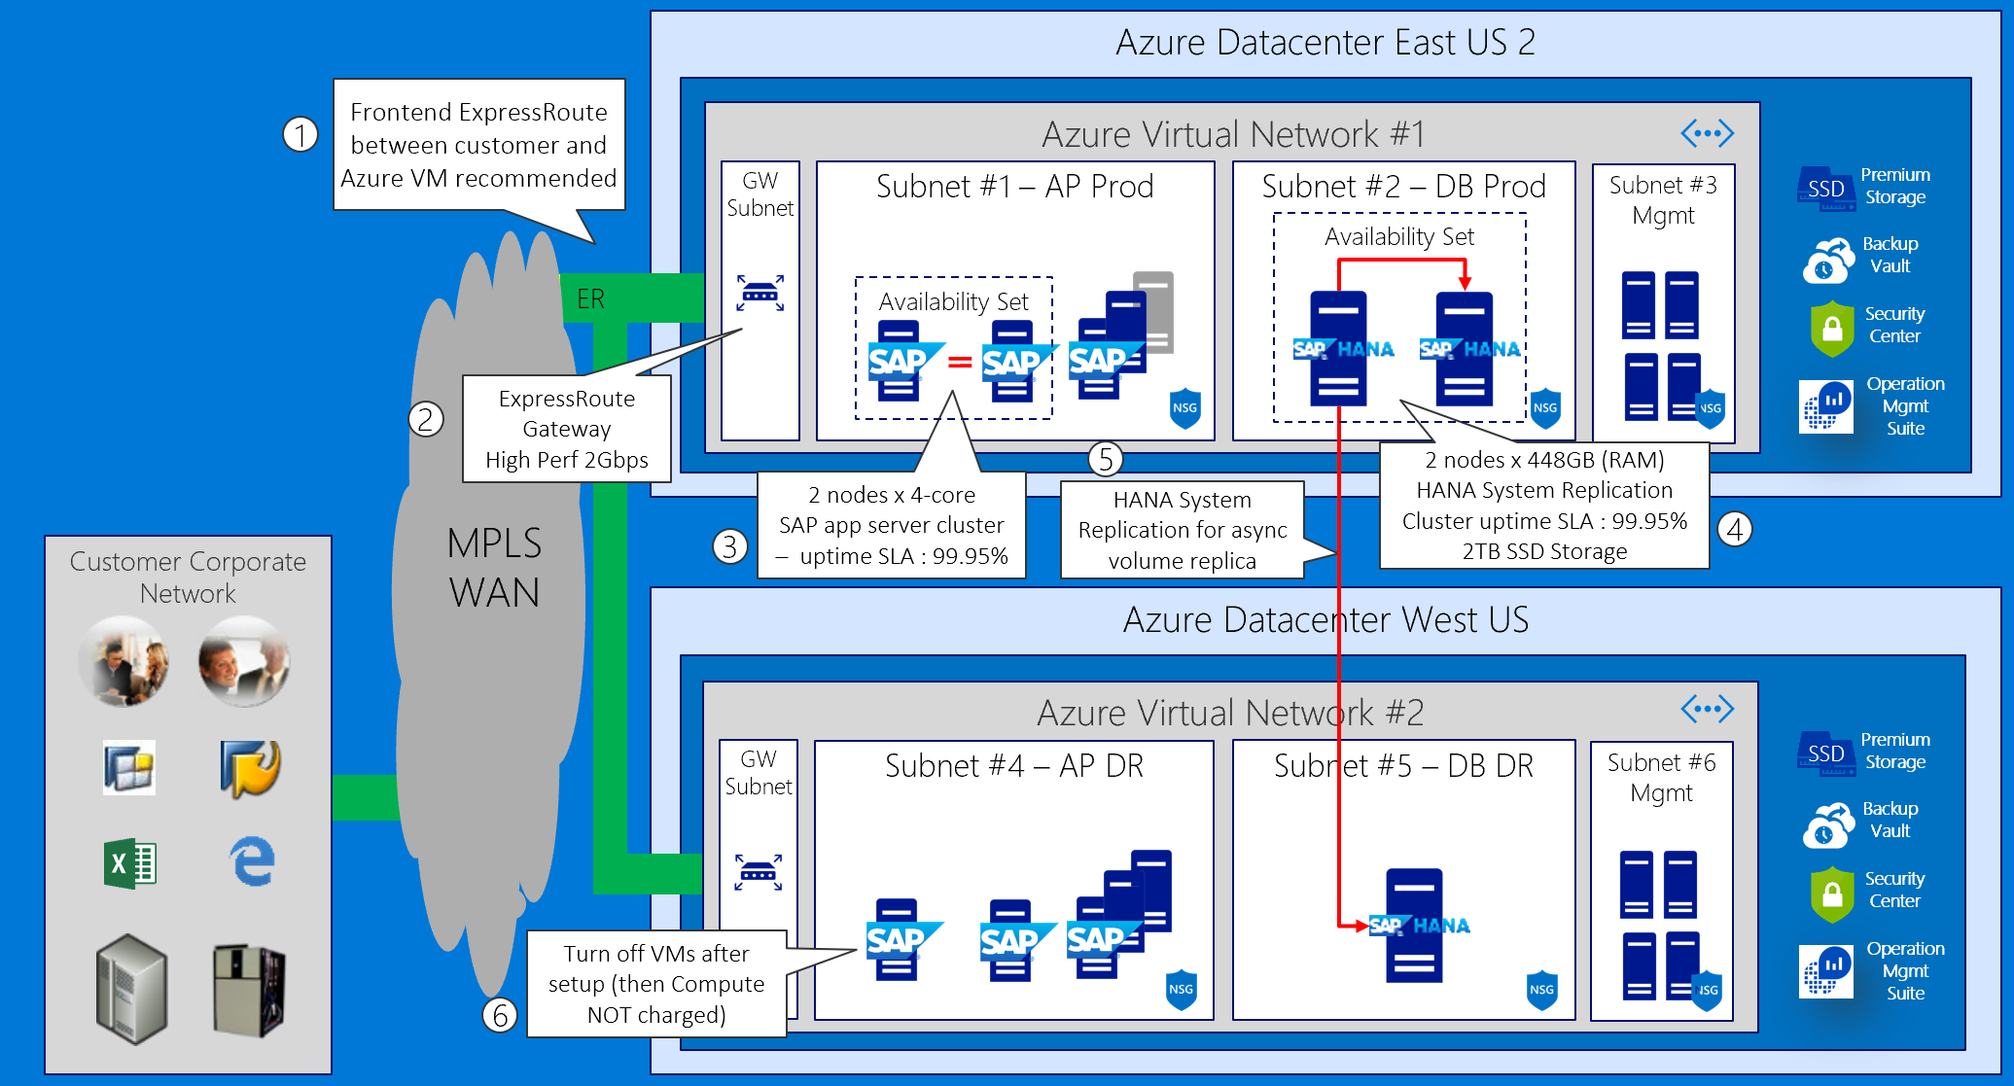
S/4HANA, BW on HANA, HANA Enterprise, Side Car – VM with HA/DR

Slide 26
Preferred objections handling
ECC remains on-premises until Dec CY18 – how can we maintain integrations between ECC and BW?
Microsoft supports a hybrid solution, with symmetry between on-premises applications and those on the public cloud
Windows Azure Virtual Network allows to create a logically isolated section in Azure and securely connect it to on premises datacenters
ExpressRoute provides secure, high-bandwidth, low-latency connectivity between Azure and on-premises datacenters

Slide 27
Preferred objections handling
How much does Azure cost? Give us a few options (e.g. HA and non-HA, DR and non-DR).
The proposed design offers three options:
Non-HA
HA with no DR
HA and DR
For mission-critical SAP applications using SAP HANA, high availability can be achieved through a highly resilient architecture with active and standby systems that have databases running with data replication. If a deployment is non-mission critical, it is possible to ensure high availability for just the data and spin up necessary compute on-demand in the event of a failure.
Disaster recovery can leverage:
Azure Site Recovery Services (A2A scenario)
Replicates SAP application instance VMs and ASCS/SCS VMs to second SAP Azure region
VMs in DR region regions are not up and running (no compute costs)
SAP HANA System Replication in asynchronous replication mode

Slide 28
Preferred objections handling
Do I have to pay for virtual machines when they
are stopped?
Azure VM must be in the stopped (deallocated) state in order to avoid compute charges. If the VM is stopped it will continue to incur charges
Deallocating does not mean deleting the VM as it still exists in storage
You will still incur storage charge even if the VM is deallocated

Slide 29
Preferred objections handling
Can I automate the shutdown of virtual machines at periodic times of day?
Yes, this functionality is available directly from the Azure portal. Alternatively, you can use Azure Automation runbooks or custom Azure PowerShell and Azure CLI scripts to stop and deallocate any instance.
The same tools can be used to start the instance on a scheduled time
Note that the built-in platform auto-shutdown functionality does not provide the draining functionality of application servers, so it is important to verify that these servers do not have any active tasks before initiating shutdown. This can be implemented by using Azure Automation or Azure functions.

Slide 30
Customer quote
“Azure has provided high availability and disaster recovery capabilities for our production environment at a very reasonable price.”
Andrew Cross, CIO, A. Datum Group

Slide 32
Appendix slides

Slide 33
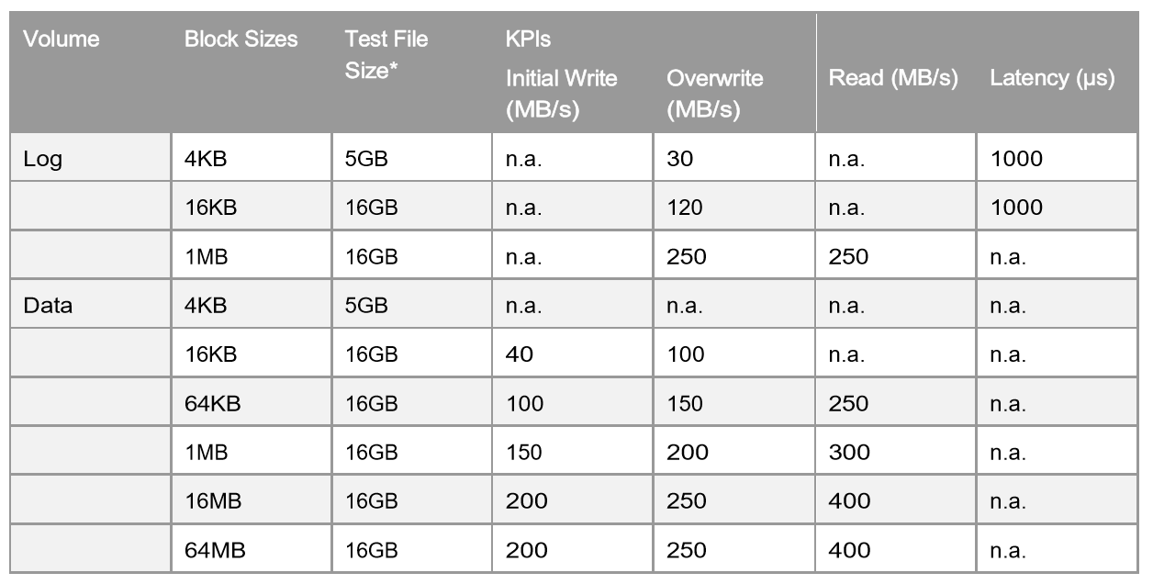
SAP HANA Hardware Configuration Check Tool (HWCCT) – KPIs for Storage (Production)
Source SAP Note: 1943937 - Hardware Configuration Check Tool - Central Note
Notes:
The HWCCT is a tool to verify that is the HANA system configuration – OS, network and storage meets the minimum performance criteria required to run SAP HANA in production.

Slide 34
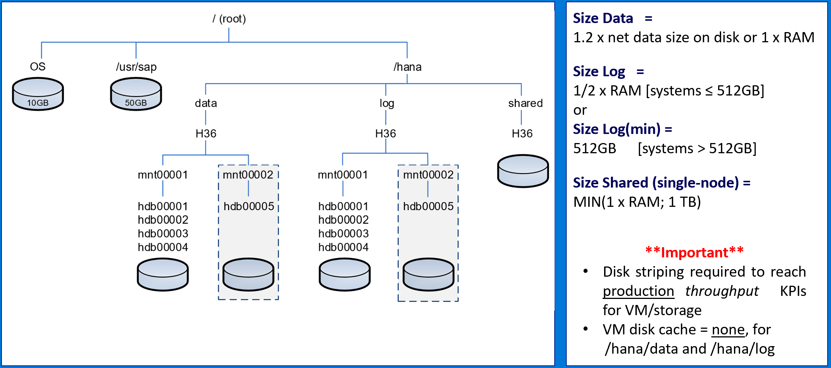
SAP HANA Storage Layout (TDI Best Practice)
Source SAP - SAP HANA Storage Requirements
Notes:
Best practice for sizing persistence (storage) for SAP HANA.

Slide 35
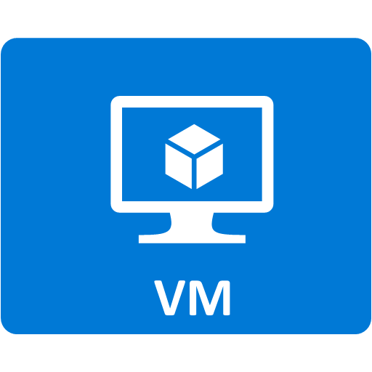
Premium Storage KPIs & Cost
Premium Storage Disk Type | P4 | P6 | P10 | P15 | P20 | P30 | P40 | P50
Disk size | 32 GB | 64 GB | 128 GB | 256 GB | 512 GB | 1024 GB (1 TB) | 2048 GB (2 TB) | 4096 GB (4 TB)
IOPS per disk | 120 | 240 | 500 | 1100 | 2,300 | 5,000 | 7,500 | 7,500
Throughput per disk | 25 MB/s | 50 MB/s | 100 MB/s | 125 MB/s | 150 MB/s | 200 MB/s | 250 MB/s | 250 MB/s
Storage Cost | $ 4.80 /month | $ 9.28 /month | $ 17.92 /month | $ 38.02 /month | $ 66.56 /month | $ 122.88 /month | $ 235.52 /month | $ 450.56 /month
Stripe (i.e. LVM) Premium Storage Managed Disks to concatenate throughput and satisfy HANA TDI/HWCCT Storage KPI’s requirements for /hana/data and hana/log
Notes:
Refer to the current slide when considering Azure VM based deployments of HANA on Azure – for both production and non-production workloads. As you can see on the current slide these options include DS series VMs – namely DS14_v2 and DS15_v2 – as well as GS series VMs, namely GS4 and GS5. Across these 4 VM sizes, we can implement systems supporting between 24,180 and 41,670 SAPS. The first three VM sizes are intended for non-production workloads, while the last one allows us to deploy SAP Business Warehouse on HANA, HANA Online Analytical Processing, and S/4HANA, with database of up to about half a TB in size. The size limit is imposed by the amount of memory available in GS5 – equal to 448 GB.
HANA database and logs must reside on Premium Storage disks. This gives us effectively three choices of disk sizes – represented by the premium storage disk types – P10, P20, P30. Each size corresponds to specific number of IOPS per disk and throughput per disk. In particular, P10 gives us 128GB of storage with 500 IOPS and 100MB/sec throughput, P20 offers 512GB of storage with 2,300 IOPS and 150MB/s, and with P30, you get 1TB of storage with 5000 IOPS and 200 MBPs. If you need to further increase these values, in terms of storage space, IOPS, or throughput, you can create multi-disk volumes by using either MDADM or logical volume manager.

Slide 36
Downtime Minimized Migration (DMO/SUM) to Azure/HANA
DMO with System Move
– change PAS host during DMO
Source SAP: DMO/SUM 1.0 SP21 Guide (source PAS must be UNIX/LINUX based)
Notes:
Downtime minimized migration to HANA via DMO/SUM – system move. Source primary application server (PAS) must be UNIX/LINUX based.

